Slide 1
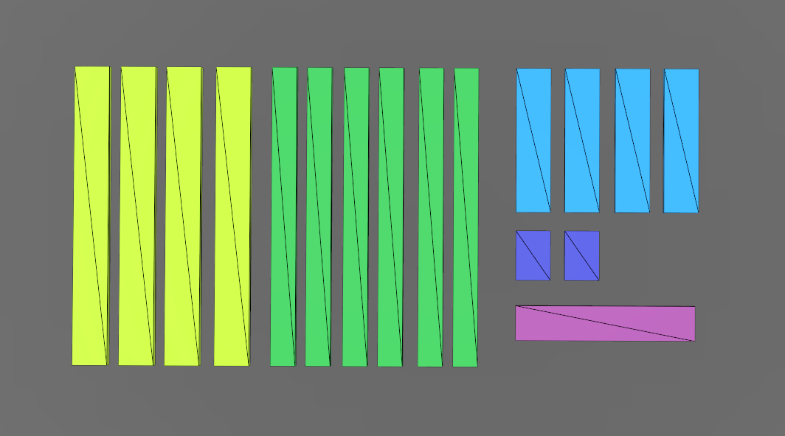
14 cm
58 cm
120 cm
20 cm
14 cm
14 cm
72 cm
14 cm
10 cm

Slide 2
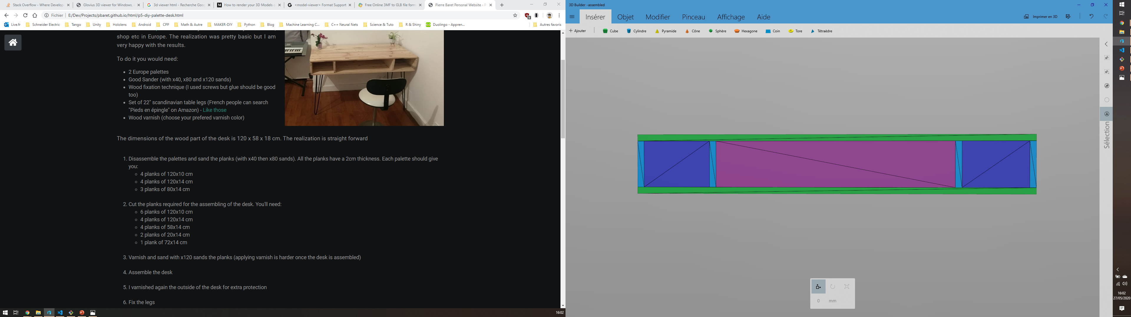
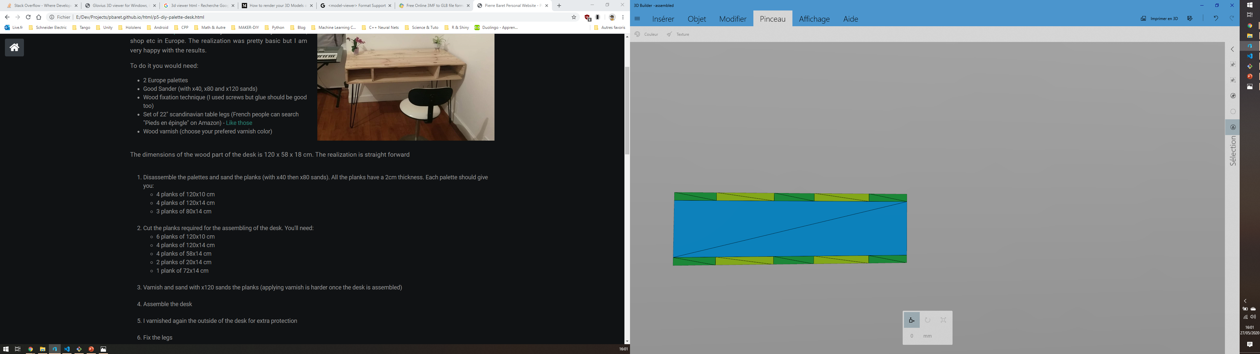
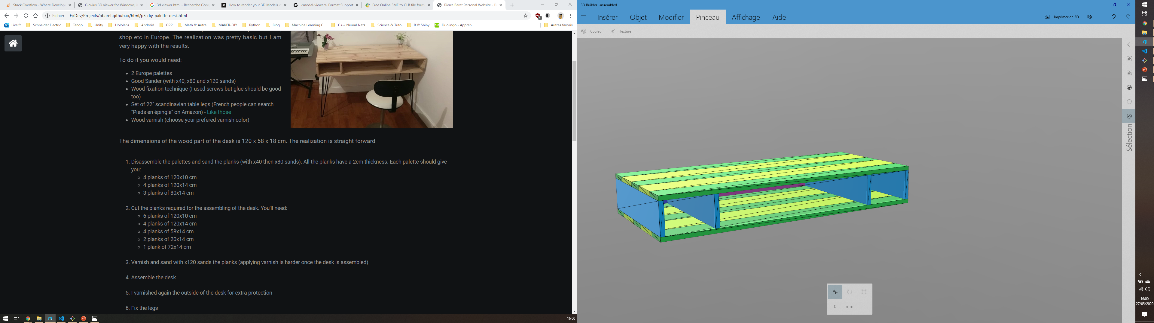
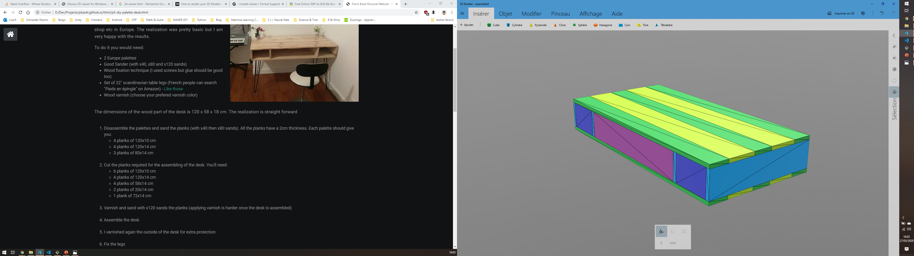
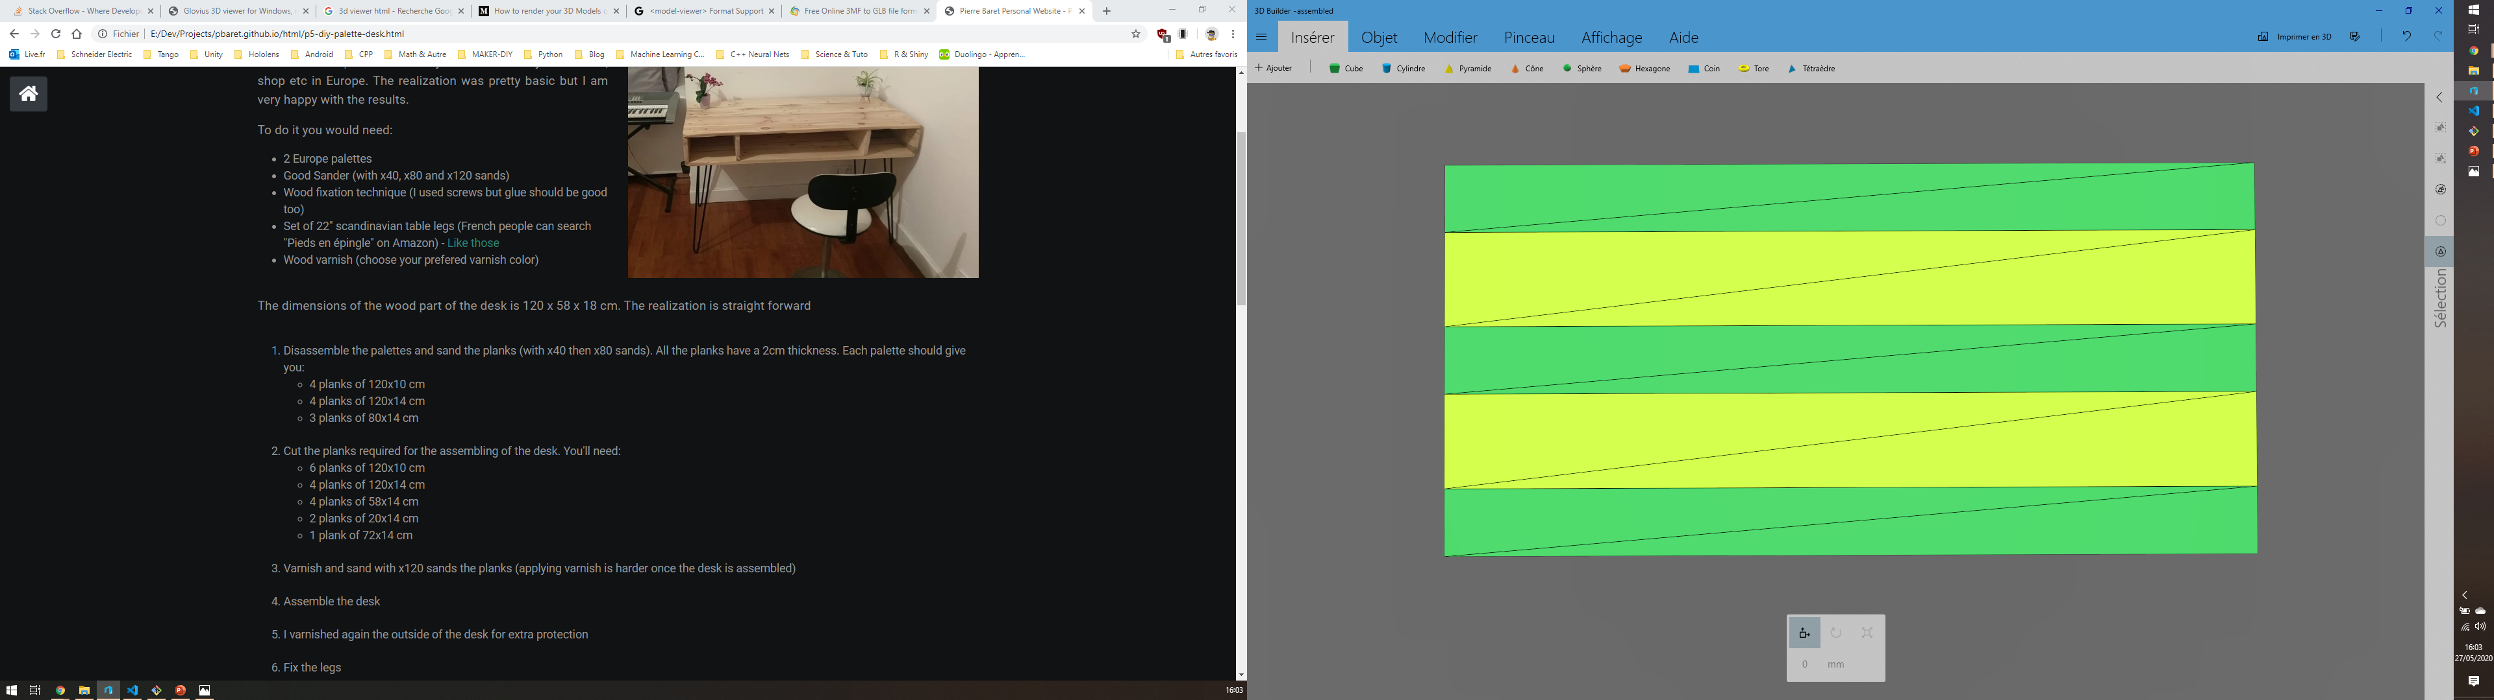

Slide 3
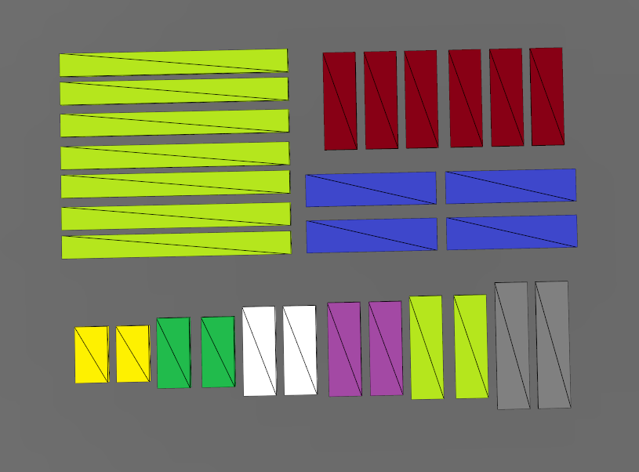
14 cm
42 cm
56 cm
10 cm
14 cm
98 cm
14 cm
14 cm
14 cm
14 cm
14 cm
14 cm
40 cm
44 cm
54 cm
24 cm
30 cm
38 cm

Slide 4
